Slide 1
Factor Analysis

Slide 2
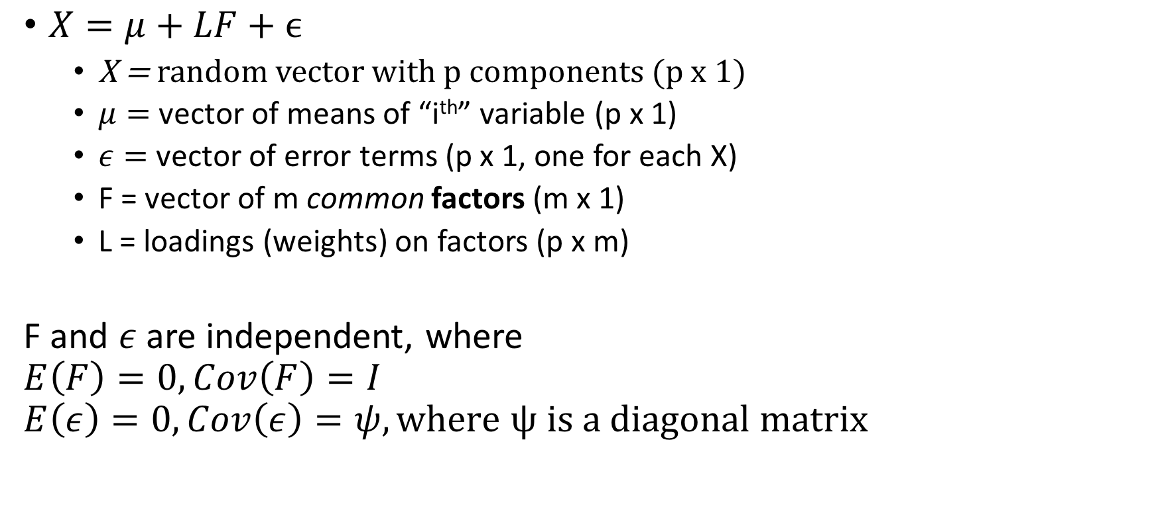
Orthogonal Factor Model with m Common Factors
$X=μ+LF+ϵ$
X = random vector with p components (p x 1)
$μ=$ vector of means of “i^{th}” variable (p x 1)
$ε=$ vector of error terms (p x 1, one for each X)
F = vector of m common factors (m x 1)
L = loadings (weights) on factors (p x m)
F and $ε$ are independent, where
$$E\left(F\right)=0, Cov\left(F\right)=I$$
$$E\left(ε\right)=0, Cov\left(ε\right)=ψ, where ψ is a diagonal matrix$$

Slide 3
Marketing Application
Total Expenditure for each consumer = Unobserved Factors * Weights + Error term
Let’s say expenditure is a function of:
Utility from Income
Response to Advertising
Distance from store
These are our factors!
But how to measure?

Slide 4
Finding Factors
Cannot observe directly, therefore must infer from other variables.
How much each customer values money (File 8)
Income
Pets
# of TV’s
Whether or not used coupons
How much he/she responds to advertising (File 11)
4 Different kinds of displays (front, end, in-aisle, other)
Ad type
Total hours exposed to commercials for any brand
How close he/she is to the store (File 6)
Frequency of trips

Slide 5
Something common to each household but different for different purchase.
Common for each purchase but different for each household.
Common things that define store (market) – exactly the same for everyone.
Advertising

Slide 6
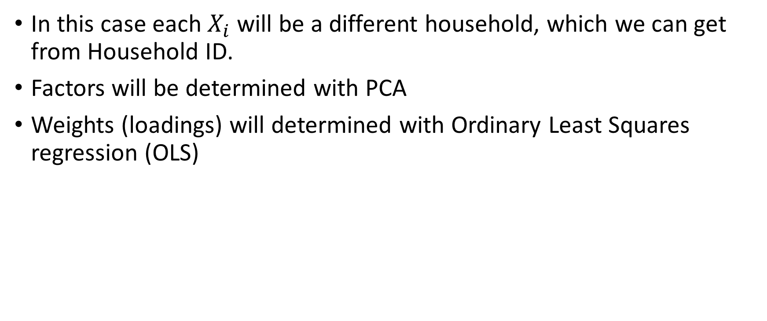
Factor Analysis Application
In this case each $X_{i}$ will be a different household, which we can get from Household ID.
Factors will be determined with PCA
Weights (loadings) will determined with Ordinary Least Squares regression (OLS)

Slide 7
Methods of Estimation
Pg. 488

Slide 8
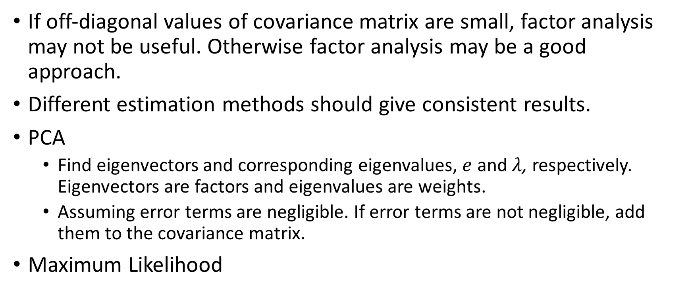
Do our factors adequately represent data?
If off-diagonal values of covariance matrix are small, factor analysis may not be useful. Otherwise factor analysis may be a good approach.
Different estimation methods should give consistent results.
PCA
Find eigenvectors and corresponding eigenvalues, $e$ and $λ$, respectively. Eigenvectors are factors and eigenvalues are weights.
Assuming error terms are negligible. If error terms are not negligible, add them to the covariance matrix.
Maximum Likelihood

Slide 9

Maximum Likelihood Estimation
Assume Normal distributions for factors $F$and errors $ε$
When jointly Normal, $X_{j}−μ=LF_{j}+ε_{j}$
Must maximize (complicated function) to obtain factor loadings. Don’t quite understand…

Slide 10
Oblique vs Orthogonal
Communality?

Slide 11
Factor Rotation
Pg. 504

Slide 12
Factor Rotation
Purpose: Provide some visual intuition of the new dimensions created from factor analysis.
When Factor Analysis is applied to a data set, the new factors can be thought of as axes, just like with PCA.
Factor rotation simply takes those new axes and rotates them such that they better fit the plotted data.
From a purely mathematical standard, not really necessary, because nothing changes. Loadings, factors, etc. all remain the same.
Orthogonal rotations (as shown in picture) assume no correlation between factors.
Oblique rotations are correlated.

Slide 13
Factor Scores
Pg. 513

Slide 14
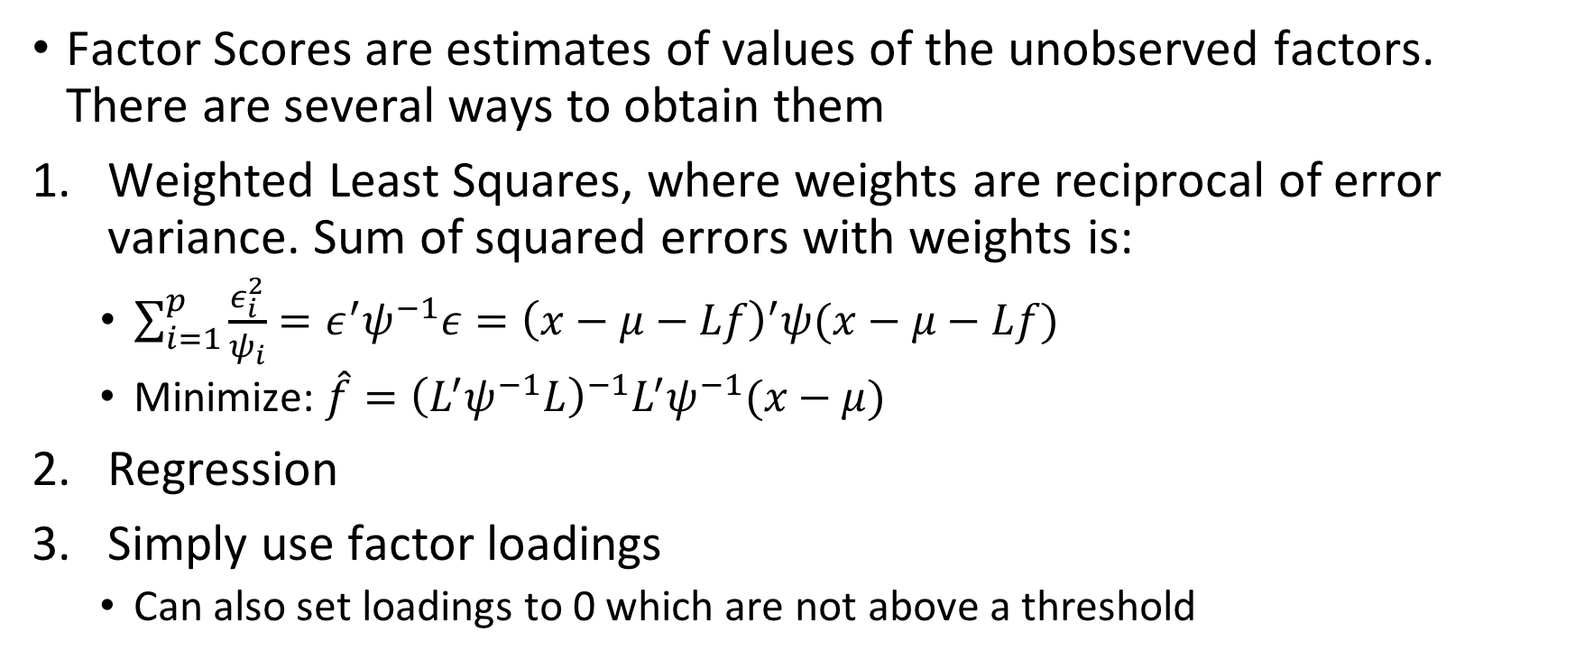
Factor Scores
Factor Scores are estimates of values of the unobserved factors. There are several ways to obtain them
Weighted Least Squares, where weights are reciprocal of error variance. Sum of squared errors with weights is:
$\sum_{i=1}^{p}{\frac{ε_{i}^{2}}{ψ_{i}}}=ε^{′}ψ^{−1}ε={\left(x−μ−Lf\right)}^{′}ψ(x−μ−Lf)$
Minimize: $\hat{f}={\left(L^{′}ψ^{−1}L\right)}^{−1}L^{′}ψ^{−1}(x−μ)$
Regression
Simply use factor loadings
Can also set loadings to 0 which are not above a threshold

